Slide 1
Abuse at scale
hearn@google.com

Slide 2
Agenda

Slide 3
Agenda
Stories from abuse@google.com
Abuse in 2012
Abuse report handling
Why it's hard
What we could do about it

Slide 4
Stories from the abyss

Slide 5
Gmail then
Launched 2004, invite only. 2006, open invites.
Gmail does not provide sender IP for web sends
Open signups make abuse fighting much harder
CAPTCHA solving teams became available, $1 per thousand CAPTCHAs.
Result>50% of all outbound mail is spam within months
Gmail abuse team split out from inbound spam and grown

Slide 6
Gmail now
No major outbound campaigns using spammy accounts
Disclaimer: still send 5,000 (legit) mails/sec
you may get sometimes get mail from @gmail.com accounts that you don't want
How?
Mail send risk analysis with hundreds of features, ML
Phone verification on suspect spamming accounts
Tactical operations against account sellers
Account signup protected by risk analysis/ML/encrypted javascript, dedicated team that monitors bulk signup

Slide 7
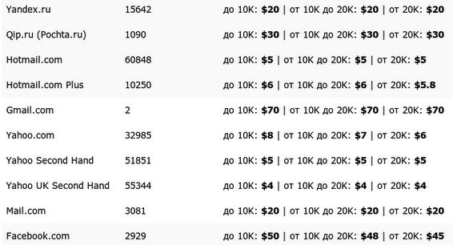
Account sellers still exist. Normal price is $120-$150 per thousand (phone verified)
This price level makes bulk spam uneconomic.

Slide 8
Problem areas
Spammers who pay for the ability to spam
Spammers who claim they will pay but don't
10,000+ engineers/product managers who are not used to thinking adversarially
Highly motivated spammers who find exploits
Students love Gmail. Let's make it available to universities!
Spammer discovers he can make fake universities: *.edu.tk is treated as valid (now fixed)
CAPTCHAs that are open to replay attacks
.... etc

Slide 9
Google abuse in 2012

Slide 10
Recent trends
April 2010 - the world changed
Bulk signup era is over
Account hijacking begins
Over 1 million sets of credentials tried per day
Successfully authenticating to >100,000 accounts per day
WTF?
The age of the password is over and never coming back

Slide 11
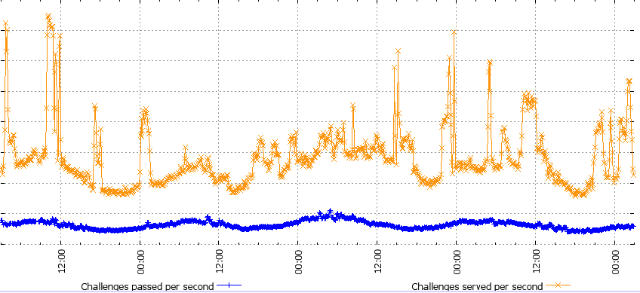

Slide 12
Solution
Abuse team becomes anti-hijacking team
Online login risk analysis
Classifies 60-100k logins per second (2-3k/sec web)
<100msec
0.1% false positive rate
2 years later, web hijacking on Gmail is largely wiped out.

Slide 13
Abuse report handling
Nobody expects the Spanish Inquisition!

Slide 14
abuse@gmail.com
Some unhappy truths:
Receives >40 reports/second
Reports grouped into "feeds"
Automatically reviewed in almost all cases
Abuse report handling is a hard problem

Slide 15
Why is processing hard?
Finding trusted feeds is tricky
Individual reports have wildly varying quality, useful only in aggregate
"Trusted partners" are incentivized to become untrusted partners
Abuse reporting mechanisms frequently gamed
Trustworthiness is not enough. You have to add coverage too.
If you have <100 users it makes no difference.
Abuse feed agreements exist between most major players, hard to avoid spamming them

Slide 16
Why is sending hard?
Abuse reports contain verbatim/lightly redacted copies of mails
Users have an expectation of privacy
People click "report spam" on mails which are not spam
Receivers should be processing abuse reports from us automatically and with reasonably good privacy controls:
Manual review for sanity checking: OK
Manual review of most abuse reports: NOT OK

Slide 17
What works best?
Feeds that aggregate large numbers of users
Feeds that have active anti-abuse teams behind them
Otherwise spammers will game the system
Feeds that use standard formats like ARF
Feeds which are automated

Slide 18
Ideas for moving forward
Upgrades to ARF:
Could distinguish "this is spam" from "this is from a friend but doesn't seem like them". Easy extension to Feedback-Type.
URL abuse (goo.gl)
Self-service tool for @google abuse feeds?
Neutral / non profit aggregators that enforce basic ground rules?

Slide 19
The end!
Thanks for listening

