Slide 1
ENUM successes – failures - alternatives
RIPE 64, April 18 2012, Ljubljana (SI)
Alexander Mayrhofer
<alexander.mayrhofer@enum.at>

Slide 2
ENUM – ecosystem components
The „Protocol“
Core protocol
Enumservice definition
IETF WG
ENUM „Flavours“
User ENUM
Infrastructure ENUM
Private ENUM

Slide 3
ENUM – ecosystem components II
User ENUM:
The „e164.arpa“ administration
Globally (RIPE‘s „root“ role)
ITU „interim procedures“
Locally (+43, ..)
Interaction with Regulators
The community
Local interaction
ENUMfederation

Slide 4
„Core“ Protocol + IETF WG
RFC2916 (2000) -> RFC3761 (2004) -> RFC6116 (2004)
Stable, deployed
(but still „proposed standard“)
Late (interesting!) alternative of the „URI RRType“.
IETF WG closed in May 2011
SUCCESS!

Slide 5
Enumservice Registration
IANA registry defined in
RFC2916 – not!
RFC3761 – IESG approval, RFC publication
RFC6117/8 – Specification Required (eases registration independent of WG existance)
Currenty 40 services (type/subtype) registered
TODO: most popular services?
SUCCESS!

Slide 6
User ENUM – Implementation (Registries part)
Registration of ENUM-Records in publicly available DNS, under control of the End User
e164.arpa administration: RIPE „root“, ITU „interim procedures“
SUCCESS! (besides some lame delegations)
*.e164.arpa administration: Implementation of registry in accordance with local regulators
SUCCESS!
ENUM Validation: Complex and resource intensive process
FAILURE (too complex in the „user control“ scenario)

Slide 7
User ENUM – industry uptake
Some very eager early adoptors
Mostly small VoIP operators
Zero large Telcos (User empowerment, „free calls“ just scary to them)
Criticial mass never reached
Left early adoptors frustrated
„Eager Operator“ report: ENUM „call rate“ below 1%, „ENUM minutes“ by magnitudes more expensive
„It‘s not about free calls, it‘s about new services“
Never happened – „Skype just works fine for me“
Minutes are cheap anyway – fixed -> mobile
FAILURE

Slide 8
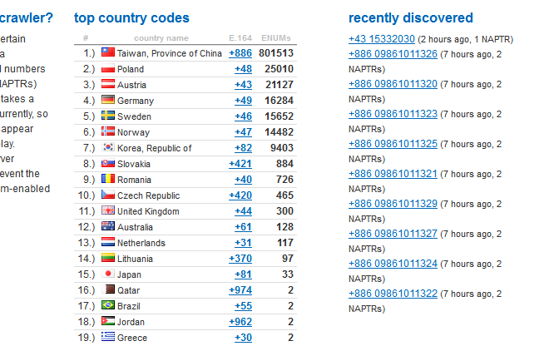
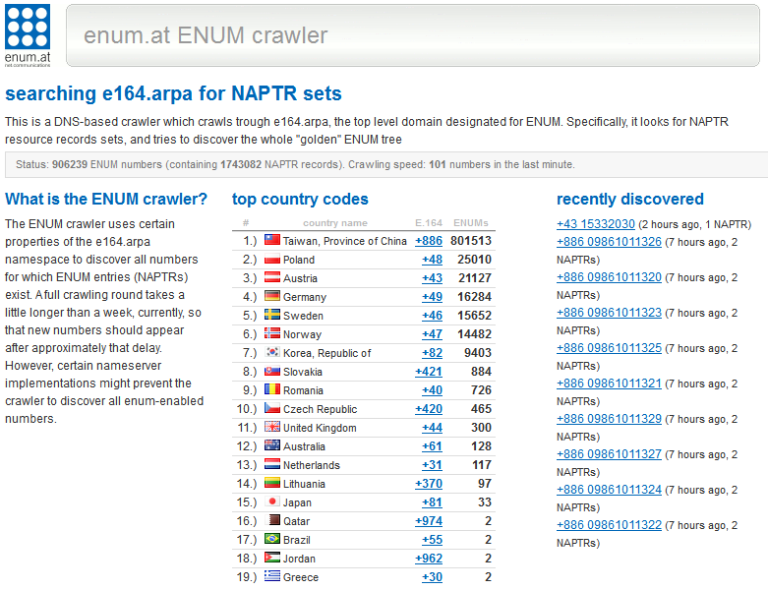
Current uptake
http://crawler.enum.at
900k numbers globally (800k in Taiwan??)

Slide 9
Infrastructure ENUM
Operator-controlled entries in the public DNS
Response to „user control is bad, we still want to use ENUM for the peering case“
Once in operation, they went silent
Zero uptake in +43
Any uptake elswhere
FAILURE – why?
Those willing already had user ENUM in place
Operators don‘t want to expose their data, market share, infrastructure
Chicken/Egg problem in VoIP-peering – ENUM solves only the „discovery“ problem

Slide 10
So, where‘s the success?
it‘s invisible.
It‘s not on the internet.
It‘s „private ENUM“

Slide 11
Private ENUM
The use of ENUM-Technology in private environments
Accessible from within an operators network only
Or within a group of operators
Or in form of a „VoIP peering point“
Massive uptake in most VoIP operator networks
SUCCESS!

Slide 12
Private ENUM use cases
Peering Scenario: Find peer organisation for a certain number
Local Number Portability queries
Caller Name queries
Internal routing queries
Selecting an outbound „trunk“ from within a network
ENUM is still the prime (only?) standardized E.164 -> identifier lookup protocol

Slide 13
Private ENUM success reasons
Implemented in almost any vendor‘s VoIP switch (even in some IMS equipment..)
DNS is well understood, scales extremely well, and supports high query loads
Private ENUM does not expose data „outside“
Allows use of „non-standard“ Enumservices
And even „hacks“ in the DNS, like client-specific answers

Slide 14
Alternatives – User ENUM
For individuals:
Skype, mobile phone, Instant Messaging
Phone numbers are not *that* important anymore (Smartphones)
And calls are cheap – normal phones *are* and alternative
ENUM requires information to be public – hinders „service discovery“ and „business card“ cases
P2Psip?

Slide 15
Alternatives – User ENUM
For enterprises:
Vendor-specific „PBX interconnect“
Least Cost Routing – calls are cheap
ViPR – http://tools.ietf.org/wg/vipr
„Built-in“ validation (via PSTN)
„Build-in“ discovery of numbers (DHT)
„New services“ rather than „free calls“ (sounds familiar ;)

Slide 16
Alternatives – Infrastructure ENUM
Bilateral agreements, employing private ENUM (if at all)
Managed „VoIP Peering Fabrics“
http://tools.ietf.org/wg/drinks
Provisioning protocol for VoIP peering data
Doesn‘t require the „output“ to be (i/p)-ENUM
But supports NAPTRs

Slide 17
Conclusion
User-ENUM: Too complex, financially unattractive, overtaken by other services
Infrastructure-ENUM: embraced only by smaller operators, scary to larger ones, solves only part of the problem (discovery)
Private ENUM: Success – at least makes use of the protocol and the services registration, but does not require the administrative infrastructure of e164.arpa…

