Slide 1
Interconnection Markets
What Works & What Doesn’t
RIPE 64, Ljubljana
April 2012
Remco van Mook

Slide 2
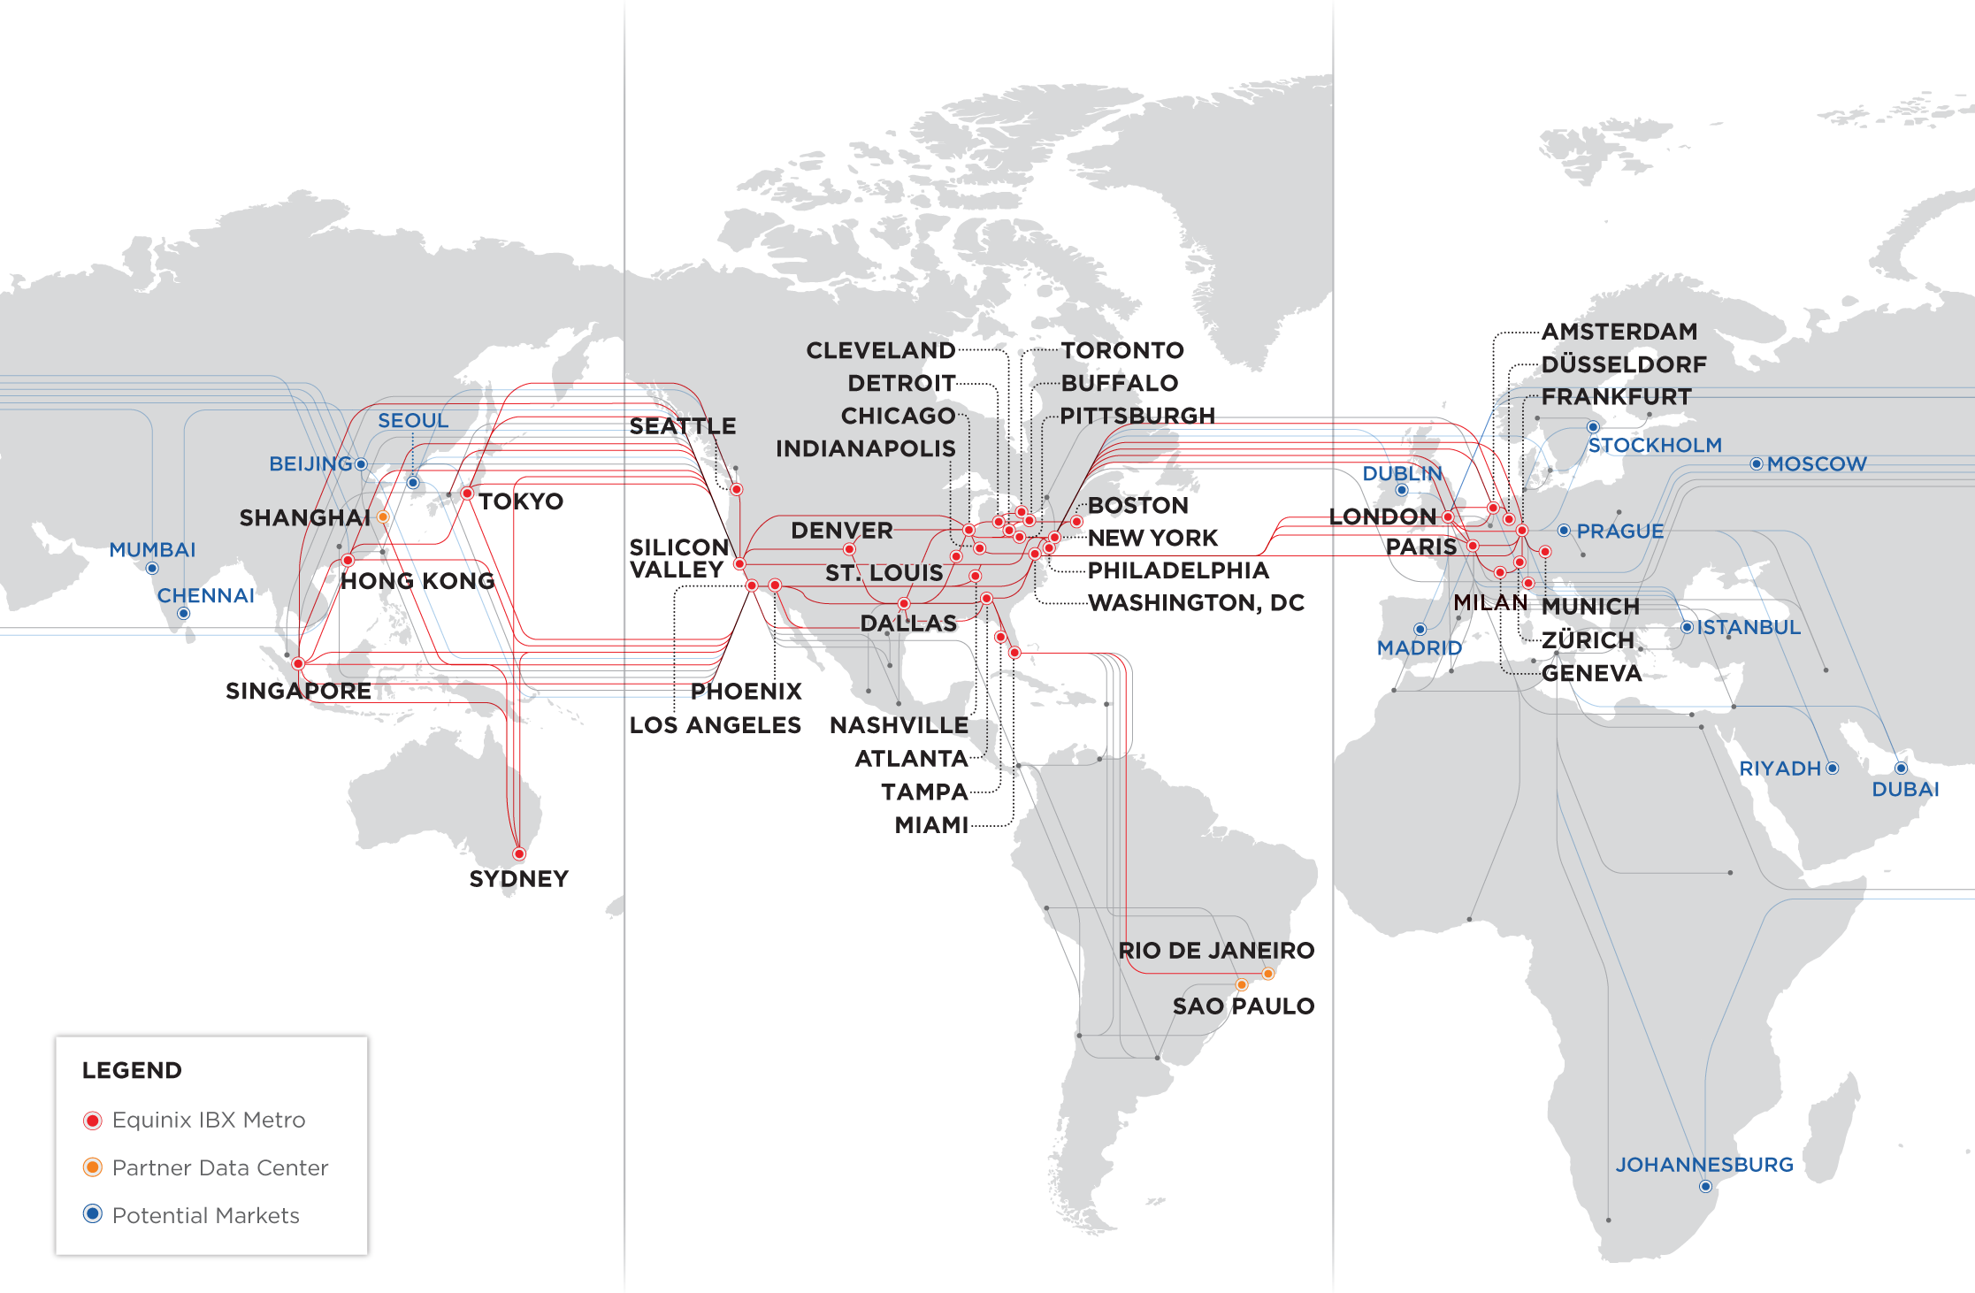
Quick Introduction
5 continents, 12 countries, 38 markets, 99 datacenters
…and a pile of Internet Exchanges

Slide 3
About me

Slide 4
The Price of Bandwidth, in bulk, per Mbps
Western Europe, early-mid 2011
A EUR80 fiber cross connect:
Internet Exchange traffic:
Backbone traffic Western Europe:
Transatlantic traffic, wholesale:
Internet Transit, wholesale:
Internet Transit, retail:
Broadband Internet, consumer:
National Ethernet service:
3G mobile data, national:
GSM voice call, national:
3G mobile data, roaming low:
3G mobile data, roaming high:
GSM voice call, roaming:
SMS Text Messages:
SMS Text Messages, roaming:
$0.01
$0.25*
$0.50
$1
$2
$15
$50
$180
$11,400
$483,840
$834,000
$3,127,500
$3,338,496
$210,000,000
$1,166,400,000
Carrier Pigeon: $2500 (est)

Slide 5
Caveat Emptor
One man’s success is another man’s failure
Local relevance is better than no relevance at all
Building Interconnection markets is hard,
Takes significant amounts of time and resources
and inordinate amounts of cooperation

Slide 6
Definition time
A Healthy Interconnection market
Has sufficient critical mass to be self-perpetuating
Has at least a regional significance
Minimizes duplication of effort

Slide 7
3 Basic Motivators
Why does a network expand its footprint?
Increase Revenue
Reduce Cost
Improve Quality
These decisions are made
For different reasons,
By different people,
In different parts of an organisation.

Slide 8
Where does it work?
Singapore
Silicon Valley
Washington DC
New York
London
Amsterdam
Frankfurt
Moscow (!)
And on a more limited scale: Stockholm, Prague, Budapest, Milan, Zurich, Madrid, …

Slide 9
No seriously, where?

Slide 10
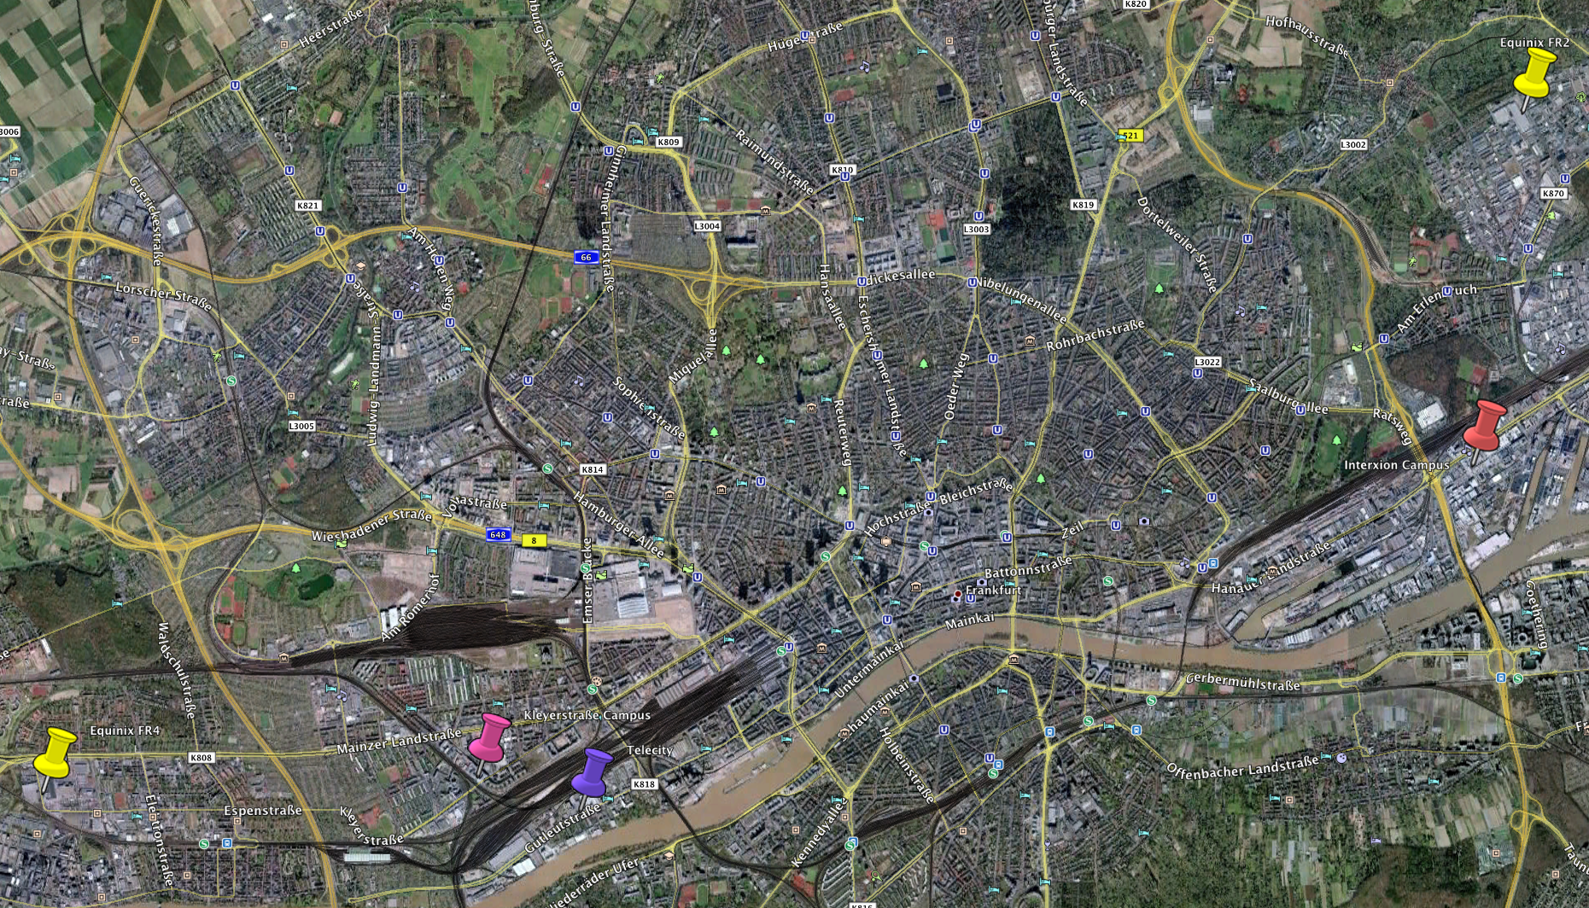
No seriously, where?
Take Frankfurt, for example:

Slide 11
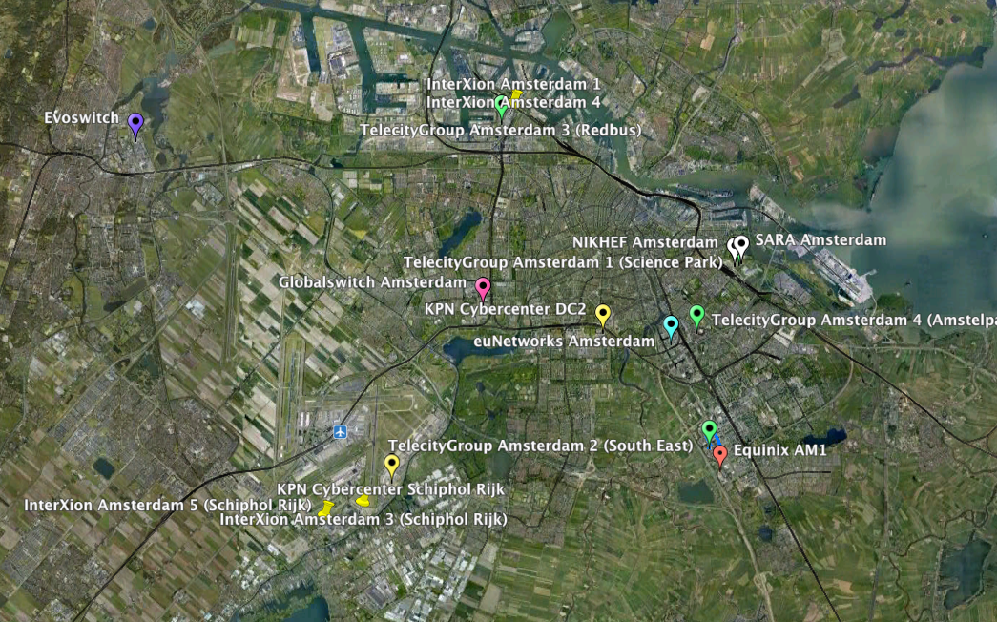
No seriously, where?
Or Amsterdam:

Slide 12
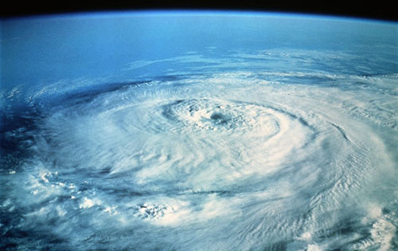
Why does it work?
A Combination of
Density
Cost
Regulatory framework
Availability and Scalability
Consolidated effort

Slide 13
Density
Without density no gravity
Without gravity no star
Without star no black hole
Without black hole no time travel (well, maybe)

Slide 14
Cost
It has to Make Sense.
Why do more people buy connectivity from a small city to a large one than the other way round?
TCO wins.

Slide 15
Regulatory framework
Void where prohibited
Deregulated telecoms is a big plus
It’s not just about laws
How about rules like
Only ISPs allowed
You MUST interconnect with everyone
“We’re doing this to screw up $telco”

Slide 16
Availability and Scalability
It’s no good if it doesn’t work
It needs to be predictable
Needs to be sustainable in the foreseeable future
Expansion space for all is vital
Retrofitting is almost always more expensive and more risky

Slide 17
Consolidated effort
You need:
Space, Power and Local Connectivity
Local/National eyeballs
Transport providers
National and International Content
Carriers
Foreign eyeballs
To work together to create a SINGLE interconnection zone

Slide 18
Conclusion
It’s not about technology
It’s not even about drinking beer (much)
There’s no magic bullet
Just a lot of hard work

